Slide 1
Youtube Recommendation Systems
Team 17: David Maser, Jiacan Li, Tianyu Liu, Flynn Hopkins

Slide 2
Youtube Business Goals
Youtube’s Recommendation System:
Introduce users to new content
Data-driven approach
Business Goals:
Increase viewership
Introduce new content
Drive revenues

Slide 3
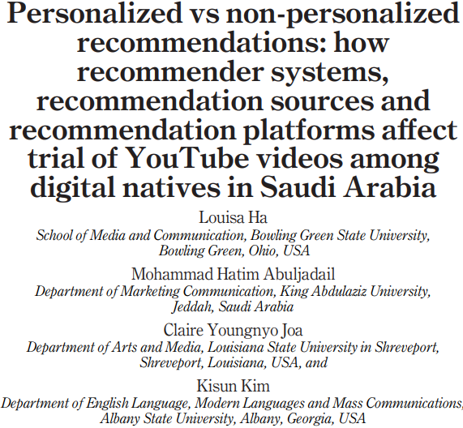
Research Paper: Background
Aim: to examine personalized vs. non-personalized recommendation in influencing user choices
Sample: 524 Saudi Arabian College Students
Method: computer-assisted self-administered interviews
Limitations: use of non-probability sample and self-reporting
Notes:
The research paper we looked into for this project took a deep dive into personalized vs. non-personalized recommendation systems in the context of youtube. Apps like youtube use recommendation systems to push content on it’s users that it believes we will enjoy, but for example our friends and family make recommendations to us about video’s all the time as well. For example a friend posting a link to a video clip on social media would be considered a non-personalized recommendation as it is being broadcast to a mass of people, rather than a video recommended to you on youtube which has been specially curated to fit you. This study aims to understand the impact both personalized and non-personalized recommendations have on influencing user choices.
The sample that was used for this study was 524 Saudi Arabian College students from two different colleges. Saudi Arabia was chosen as it is youtube’s largest market for mobile videos and is amongst the highest countries in per capita youtube watch time statistics. The 524 students come from two different college, one being an all boys school and the other being an all girls school. This was done in order to to do some further analysis into what effects gender might have on recommendation systems effects on users. College students were also chosen as they are digital natives and are within the age range of the largest video content consumers.
The method used to gather data was a computer assisted self administered interview where the students would answer various questions about their youtube viewing habits and how they interact with recommendation systems. The interview contained 38 questions and the students responded to each question using a using a number scale for example 1 to 7. The amount of numbers on the scale would depend on the question but the range they covered was generally the same as the lowest number would suggest daily use and the highest being no use at all. The question topics included youtube recommended video use, recommendation sources, sharing on social media, and video genre diversity.
Some of the limitations of this study are the use of a non-probability sample and the self-reporting mechanism. By non-probability sample, what that means is the sample of people chosen was not random, therefore the bias that lead to the eventual sample being chose could result is skewed data that does not represent the overall world of youtube users. As for the self-reporting mechanism, this can result in either an over or under estimation of video use. If the data were to be collected in real time and the users went about their youtube use, the data would be accurate and represent the users actual tendencies. With self-reporting, users self understanding of their own usage could be embellished either to put themselves in a certain category of to tell the survey operates what they think they want to hear.

Slide 4
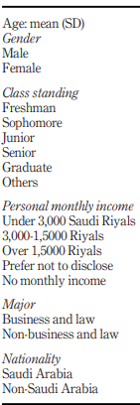

Research Paper: Results
88% of users admitted they watch the recommended videos on their Youtube homepage
“Heavy” users are more likely to view recommended videos
Gender is a significant predictor of recommended video use intensity
The more users use recommendation systems, the more diverse their viewing genres and likelihood of sharing are
Notes:
Results
One of the first results generated from this survey is they found that 93% of the students admitted that they are likely to watch the videos recommended to them on their homepage. This figure is about the same as the likelihood users admitted they are to watch a video posted to social media by friends or family which was 94%. This shows that both personalized and non-personalized recommendations play a significant role in generating watch time on youtube.
They also conducted analysis on heavy vs. light users of youtube and how likely they were to watch videos recommended by youtube. Heavy users of youtube were found to be more likely to watch recommended videos than light users. The increased viewing went beyond just youtube’s recommendations as they were also more likely to watch videos recommended by youtubers they watch.
When conducting a regression analysis of the how different factors of the individual students such as class, age, income, nationality, etc., effect video use intensity, they found that the only significant attribute in determining whether or not a user would have a high intensity is if they were a male or not. This was something that went against the authors hypothesis into what they thought they would find in the data as the suspected women would be more influenced by recommendation systems than men. Prior research cited by the others suggested that women are more trusting than men and are more likely to be influenced by online recommendations as a result.
In regards to genre diversity, the authors found that the more users watched videos that were recommended to them, the more diverse the video genres got. They also found that the more people use youtube recommended videos, the more likely they are to share them on social media. These to findings are significant as they begin to show the compounding effect youtube recommendation systems can have on the type of content people see and the extent at which that content is disseminated to others to see. The implications and ethical concerns of this will be covered more later but for now I will allow dave to show you all our coding demo.

Slide 5
Explainability & Ethical concerns
Users only view opinions that they support or enjoy, limiting their scope of information consumed.
A recommendation system whose goal is to increase user watch time and promote interaction on the platform may struggle to put accurate and unbiased information in front of users.
“Earth is flat” explainability example
Users may like, share, and rate highly videos discussing flat Earth and how the earth is not round, but these are the types of low-quality videos you wouldn’t want widely promoted as they are obviously untrue.
recommendation systems can perpetuate biases or reinforce existing stereotypes if they are not designed with care

Slide 6
Conclusion: What’s Next, Envision Future Developments
Continual learning and development
Continued optimization
Optimized search bar recommendations
Ethics
Add a tag/flag for irresponsible and unethical content
Introduce more human interaction to verify correct labels/recommendations

Slide 7
References
Ha, L., Mohammad, H. A., Joa, C. Y., & Kim, K. (2022). Personalized vs non-personalized recommendations: How recommender systems, recommendation sources and recommendation platforms affect trial of YouTube videos among digital natives in saudi arabia. Journal of Islamic Marketing, 13(12), 2778-2797. doi:https://doi.org/10.1108/JIMA-12-2020-0384

